Slide 1
Using Jupyter Notebooks to Improve Operational Efficiency

Slide 2
Using Jupyter Notebooks to Improve Operational Efficiency

Slide 3
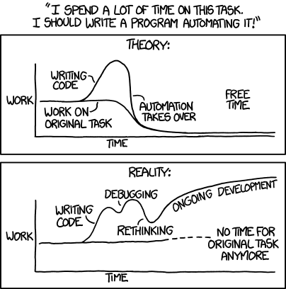
Is automation worth it?
'Automating' comes from the roots 'auto-' meaning 'self-', and 'mating', meaning 'screwing'.
https://xkcd.com/1319/

Slide 4
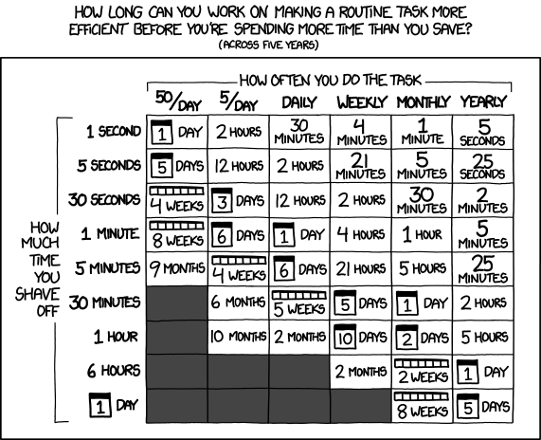
Is automation worth it?
'Automating' comes from the roots 'auto-' meaning 'self-', and 'mating', meaning 'screwing'.
“…every second counts toward your life total, including these right now.
https://xkcd.com/1319/
https://xkcd.com/1205/

Slide 5
Is automation worth it?
'Automating' comes from the roots 'auto-' meaning 'self-', and 'mating', meaning 'screwing'.
“…every second counts toward your life total, including these right now.
https://xkcd.com/1319/
https://xkcd.com/1205/

Slide 6




What are these new tools?
How can you get started?
How can you use this? (Demo)
What else can you do? (Demo)

Slide 7


What are these new tools?
Interactive Computing Ecosystem
Notebook Format
Client (.ipynb)
Interactive Protocol
(ZeroMQ)
Kernels
Server (Python, C#, PS, etc…)

Slide 8


What are these new tools?
Interactive Computing Ecosystem
Notebook Format
Client (.ipynb)
Interactive Protocol
(ZeroMQ)
Kernels
Server (Python, C#, PS, etc…)
.NET Interactive (Kernels)
Python (Kernels)
Python, Anaconda, & 70+ languages
PowerShell, C#, SQL, & more

Slide 9


What are these new tools?
Interactive Computing Ecosystem
Notebook Format
Client (.ipynb)
Interactive Protocol
(ZeroMQ)
Kernels
Server (Python, C#, PS, etc…)
.NET Interactive (Kernels)
Python (Kernels)
Python, Anaconda, & 70+ languages
PowerShell, C#, SQL, & more
Polyglot Notebooks Extension
Familiar Visual Studio Code Experience
Rich Notebook Authoring
Use Kernels Locally

Slide 10
What are these new tools?
How can you get started?
How can you use this? (Demo)
What else can you do? (Demo)

Slide 11



How can you get started?
Windows
Mac
Linux
Install Visual Studio Code
winget install `
--id Microsoft.VisualStudioCode
https://code.visualstudio.com/download

Slide 12
How can you get started?
Windows
Mac
Linux
Install Visual Studio Code
winget install `
--id Microsoft.VisualStudioCode
https://code.visualstudio.com/download
Install .NET SDK
winget install `
--id Microsoft.DotNet.SDK.7 `
--log C:\temp\temp.log
https://dotnet.microsoft.com/download

Slide 13
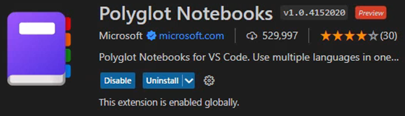
How can you get started?
Windows
Mac
Linux
Install Visual Studio Code
winget install `
--id Microsoft.VisualStudioCode
https://code.visualstudio.com/download
Install .NET SDK
winget install `
--id Microsoft.DotNet.SDK.7 `
--log C:\temp\temp.log
https://dotnet.microsoft.com/download
Install Polyglot Notebooks
Visual Studio Code Extension
https://marketplace.visualstudio.com/items?itemName=ms-dotnettools.dotnet-interactive-vscode

Slide 14

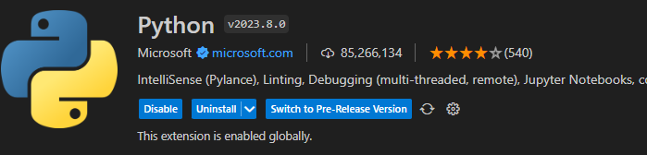
How can you get started?
Windows
Mac
Linux
Install Visual Studio Code
winget install `
--id Microsoft.VisualStudioCode
https://code.visualstudio.com/download
Install Anaconda
Miniconda, Python, etc…
winget install `
--id Anaconinstallda.Anaconda3
https://www.anaconda.com/download
Install Python
Visual Studio Code Extension
https://marketplace.visualstudio.com/items?itemName=ms-python.python

Slide 15
What are these new tools?
How can you get started?
How can you use this? (Demo)
What else can you do? (Demo)

Slide 16
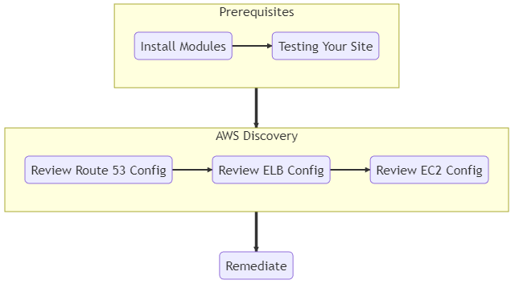

How can you use this?
https://mermaid.js.org

Slide 17
What are these new tools?
How can you get started?
How can you use this? (Demo)
What else can you do? (Demo)

Slide 18

What else can you do?
Employee’s Experience
Build confidence
Baseline skills
Contribute quickly
Documentation is useful

Slide 19

What else can you do?
Employee’s Experience
Build confidence
Baseline skills
Contribute quickly
Documentation is useful
Organization’s Experience
Accessible by Multiple Users
Secure with Single Sign-On
Centralized Management
Consistent & Cost Efficient

Slide 20

What else can you do?
Employee’s Experience
Next Steps
Build confidence
Baseline skills
Contribute quickly
Documentation is useful
Privileged & Remote Access
Organization’s Experience
Accessible by Multiple Users
Secure with Single Sign-On
Centralized Management
Consistent & Cost Efficient

Slide 21
What else can you do?
Employee’s Experience
Next Steps
Build confidence
Baseline skills
Contribute quickly
Documentation is useful
Privileged & Remote Access
Collaborate Across 70+ Languages
Organization’s Experience
Accessible by Multiple Users
Secure with Single Sign-On
Centralized Management
Consistent & Cost Efficient

Slide 22

What else can you do?
Employee’s Experience
Next Steps
Build confidence
Baseline skills
Contribute quickly
Documentation is useful
Privileged & Remote Access
Collaborate Across 70+ Languages
Organization’s Experience
Documentation is Time Consuming, Use Modern Tools
Accessible by Multiple Users
Secure with Single Sign-On
Centralized Management
Consistent & Cost Efficient

Slide 23
What else can you do?
“…every second counts toward your life total, including these right now.
https://xkcd.com/1205/

Slide 24








Who is Michael Soule?
Michael Soule
National Director
Sentinel Technologies
misoule@sentinel.com
Migration & Modernization
Identity & Security
Hybrid Cloud
Licensing & Cost Optimization

Slide 25
Additional References
This content | https://github.com/Snozzberries/jupyterDemo
.Net Interactive GitHub Docs | https://github.com/dotnet/interactive/blob/main/docs/NotebookswithJupyter.md
Ideas for the Graph API demo | https://www.youtube.com/watch?v=ib3BrVNQkFM
Good practices for Read, Eval, Print, Loop | https://nbdev.fast.ai/tutorials/best_practices.html
JupyterHub Fargate Spawner | https://github.com/uktrade/fargatespawner
JupyterHub Azure AD Authenticator | https://oauthenticator.readthedocs.io/en/stable/getting-started.html
Mermaid diagrams project | https://mermaid.js.org/
Convert notebooks to other formats | https://nbconvert.readthedocs.io/
Automatic GitHub to Jupyter | https://mybinder.org/
.Net Interactive Magic Commands | https://github.com/dotnet/interactive/blob/main/docs/magic-commands.md
Get Started with PowerShell Notebooks | https://github.com/dfinke/powershell-notebooks
PowerShell AI Module (NoteBook Copilot) | https://github.com/dfinke/PowerShellAI
Parameterize and automate Notebooks | https://papermill.readthedocs.io/en/latest/

